Slide 1

K-Force Global: Blockchain-Verified Energy Management
Tokenizing ISO 50001 Compliance for the Digital Green Economy
Transforming how organizations verify, report, and monetize energy savings through blockchain technology and ISO 50001 certification.

Slide 2

The Energy Management Crisis
Massive Energy Expenditure
ESG Reporting Challenges
The U.S. industrial sector alone spends $200 billion annually on energy while consuming 32% of the nation's total energy output.
Companies invest $6 billion annually in ESG disclosures, yet 70% of investors distrust the data due to lack of verification.
Compliance Complexity
Energy management standards like ISO 50001 offer structure but struggle with transparent verification and monetization of improvements.

Slide 3
The Market Opportunity
The convergence of ISO standards adoption, growing ESG investments, and carbon markets creates a unique opportunity for verified energy management solutions.
500K+
$40T
$15B
Potential ISO 50001 Adopters
ESG Asset Market by 2030
Carbon Credit Tokenization
Over 500,000 organizations already certified to ISO 14001 represent immediate potential adopters for ISO 50001 energy management certification.
The global ESG asset market is projected to reach $40 trillion by 2030, driving demand for verifiable energy efficiency data.
The carbon credit tokenization market is expected to reach $10-15 billion annually by 2030 according to World Bank and BCG analysis.

Slide 4





Introducing the K-Force Platform
"IoT-powered blockchain verification for ISO 50001 compliance — tokenizing every kilowatt saved and every ton of CO₂ avoided."
IoT Sensors
Blockchain Ledger
Capture real-time energy consumption data across industrial processes and systems
Secures and immutably records energy performance data with timestamp verification
Verified Action
Tokenized Asset
Automated compliance with ISO 50001 standards and requirements
Creation of tradable digital assets representing verified energy savings

Slide 5
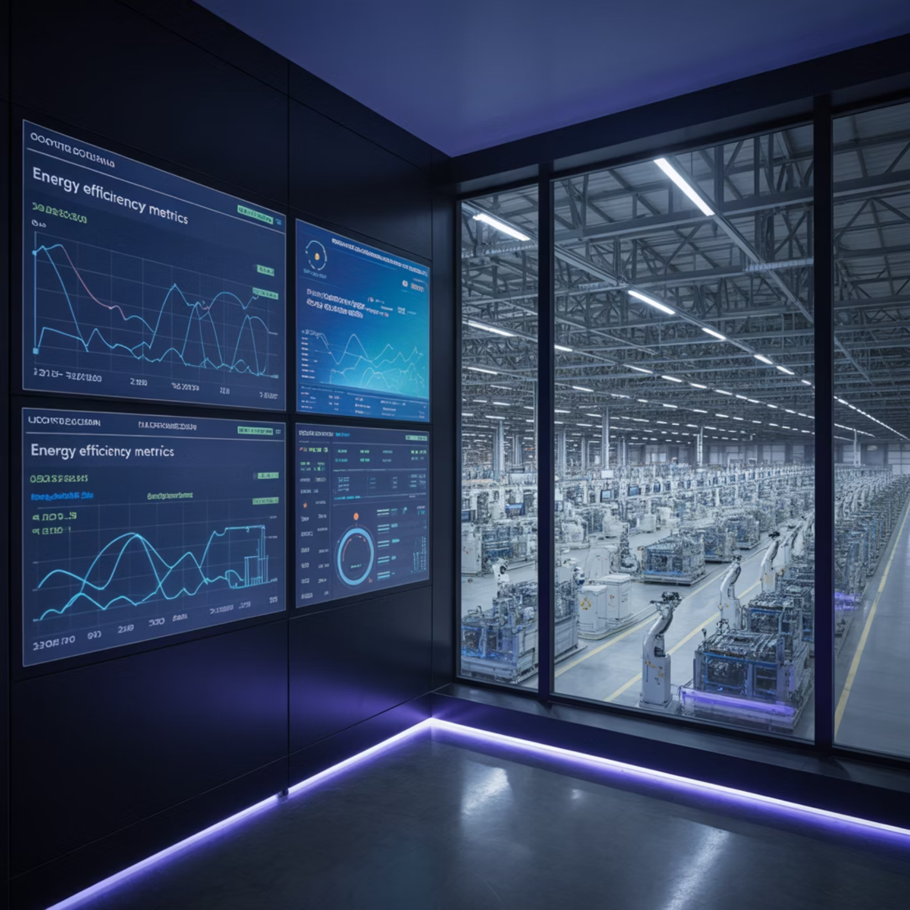

Real-World Application
Case Study: Manufacturing Facility
10% energy consumption reduction through efficiency upgrades (~$5M annual savings)
IoT sensors capture and verify real-time savings
Blockchain secures data against manipulation
Digital tokens generated as proof-of-savings
Monetization Pathways:
ESG reporting with verifiable Scope 1 & 2 reductions
Carbon credit generation (~$50/ton CO₂)
Preferential terms on green bonds and sustainability-linked loans

Slide 6
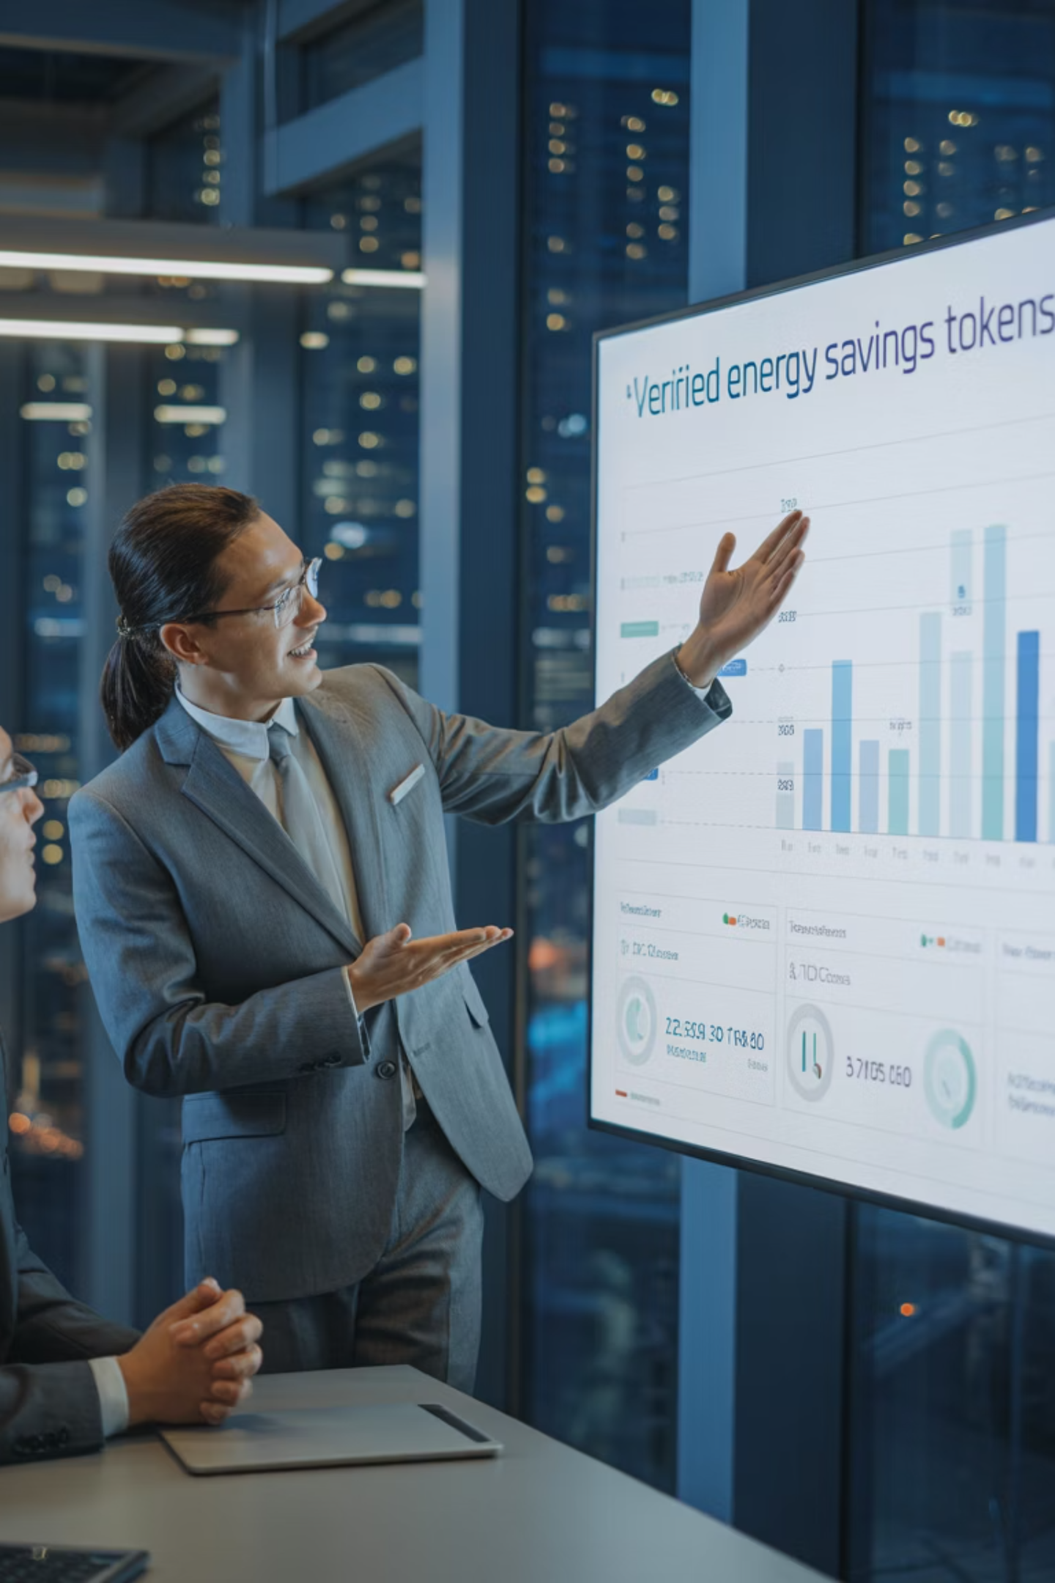
Validation & Traction
DOE Programs Alignment
Growing ISO 50001 Momentum
The DOE's Industrial Technologies Validation (ITV) Program demonstrates industrial adoption of emerging technologies but lacks verifiable measurement, reporting, and verification (MRV) — which K-Force directly addresses.
ISO 50001 & 50001 Ready adoption is accelerating with over $3M invested by the Department of Energy to promote uptake among U.S. manufacturers.

Slide 7
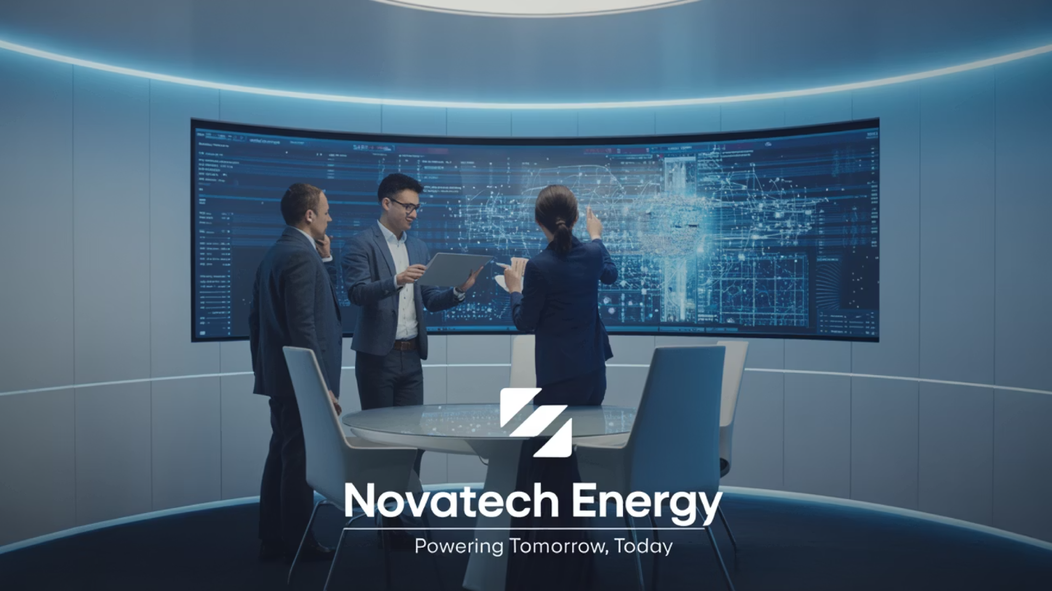

Powering the Digital Green Economy
Leadership Team
Our executive team combines decades of experience across blockchain technology, IoT systems integration, energy management, and ESG reporting compliance, supported by advisory board members from DOE and ISO certification programs.
"Every kilowatt saved and every ton of CO₂ avoided can now be verified, tokenized, and monetized."
Next Steps
Schedule a platform demonstration
Discuss pilot program opportunities
Explore partnership possibilities
K-Force Global is making ISO 50001 the backbone of the digital green economy. Join us in transforming how industry manages, verifies, and monetizes energy efficiency.

